Slide 1

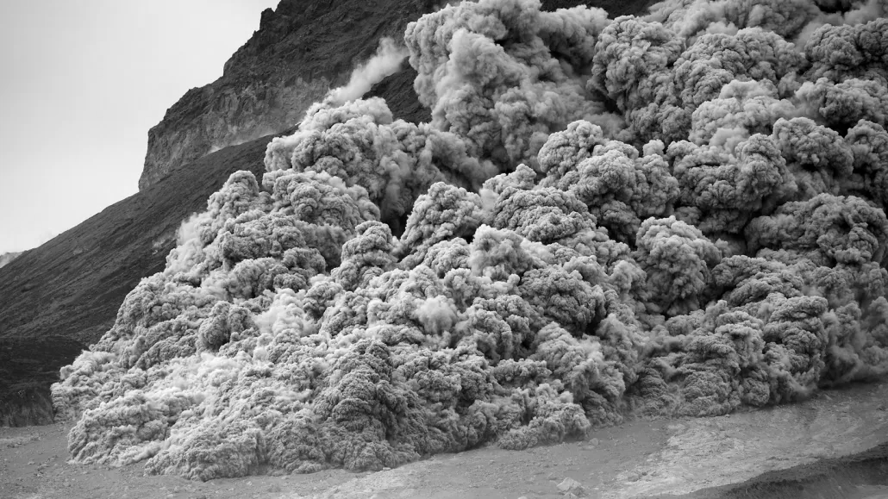
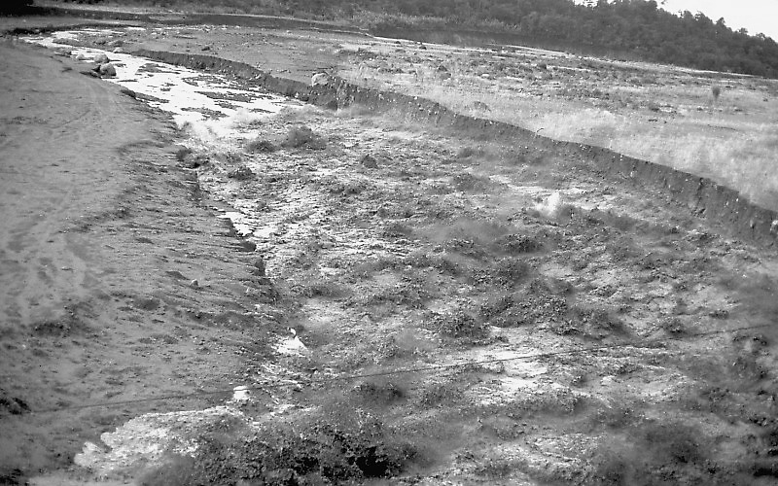
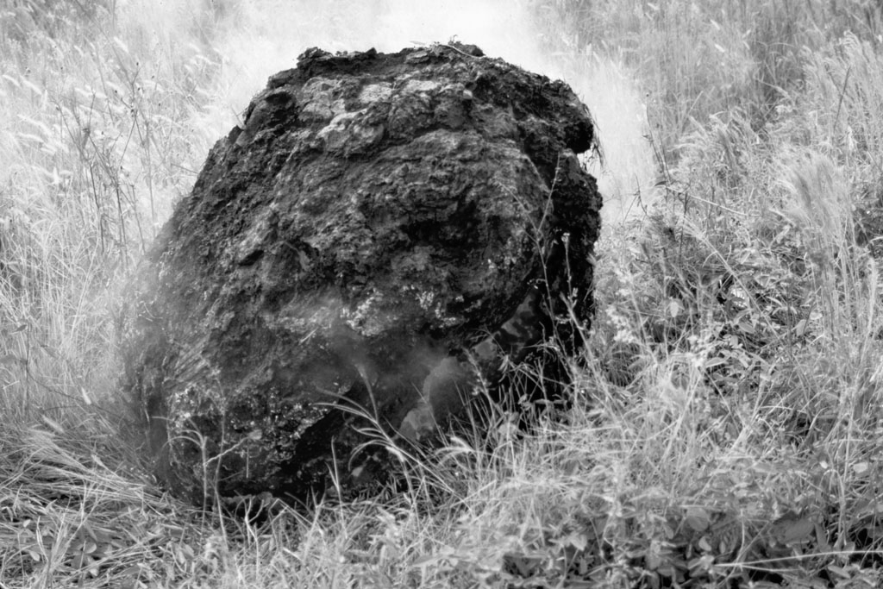
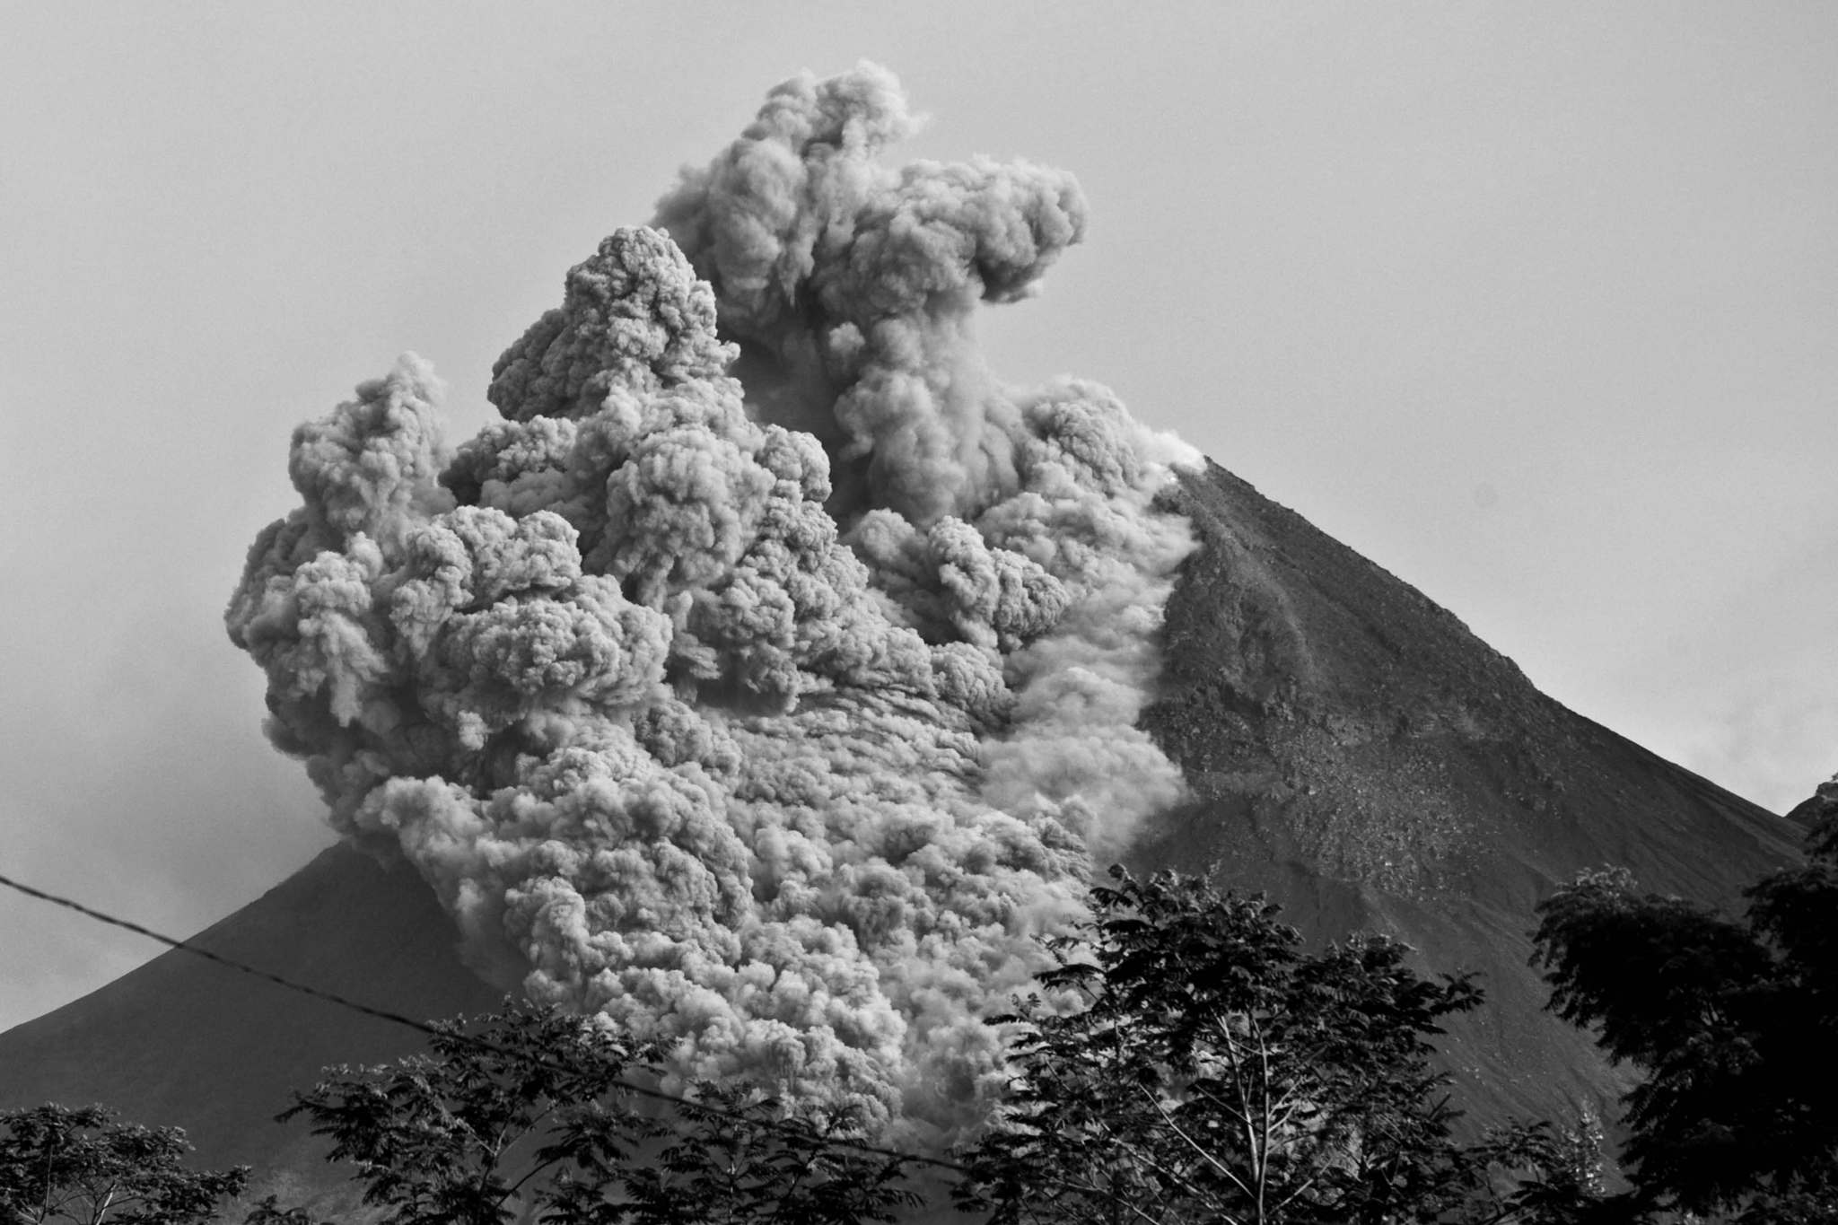
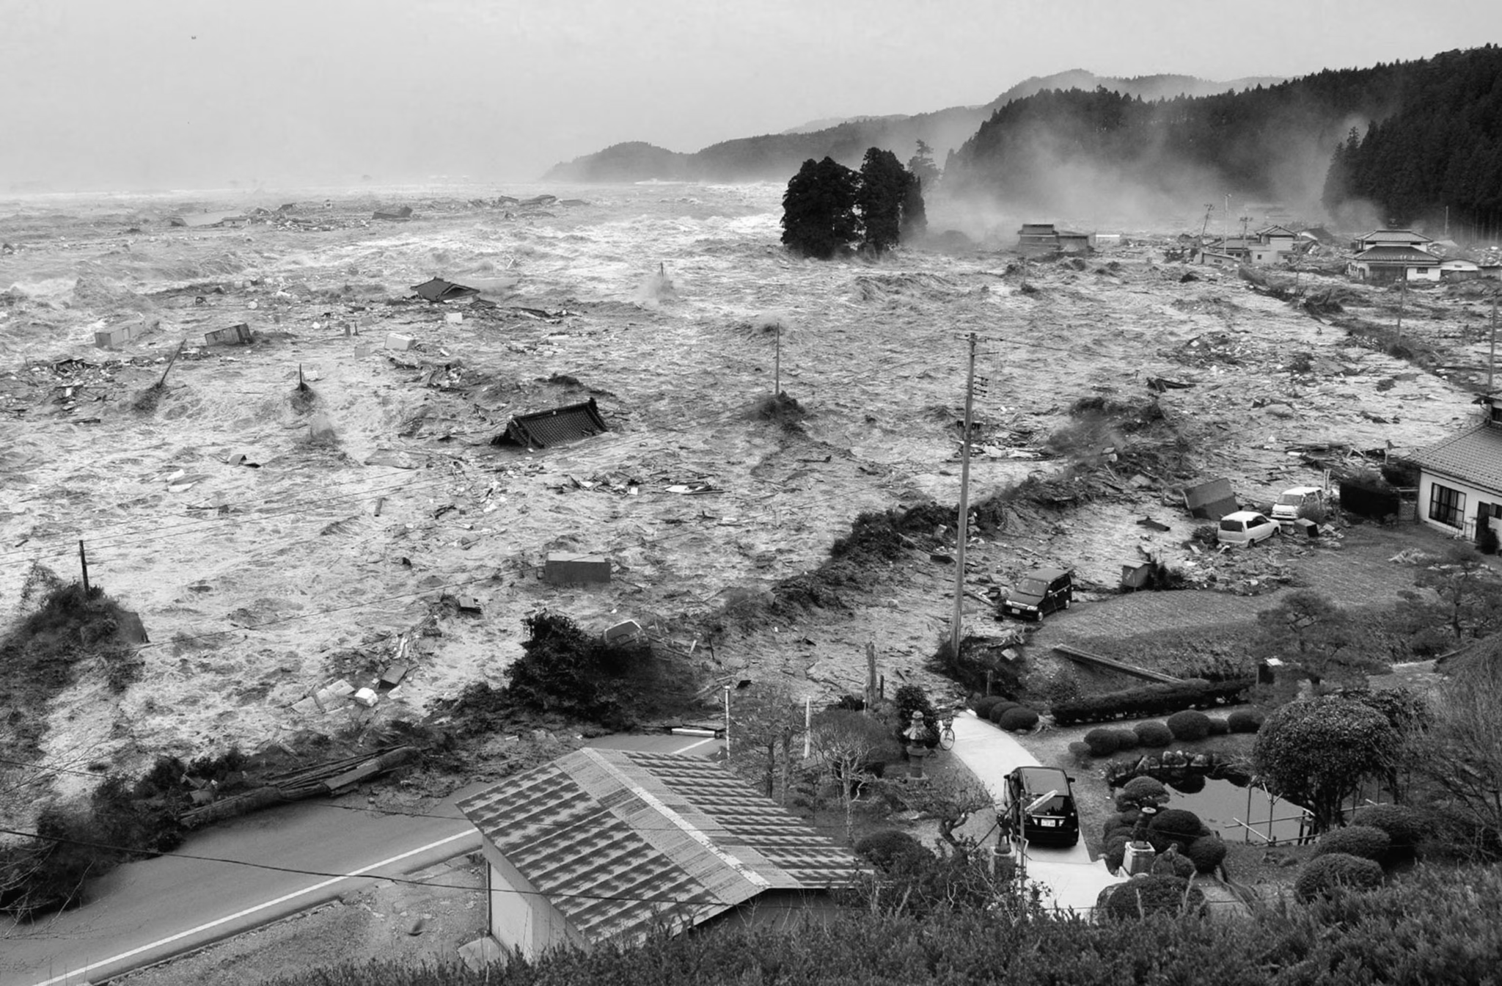

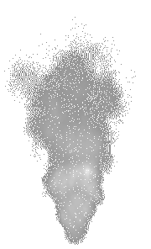


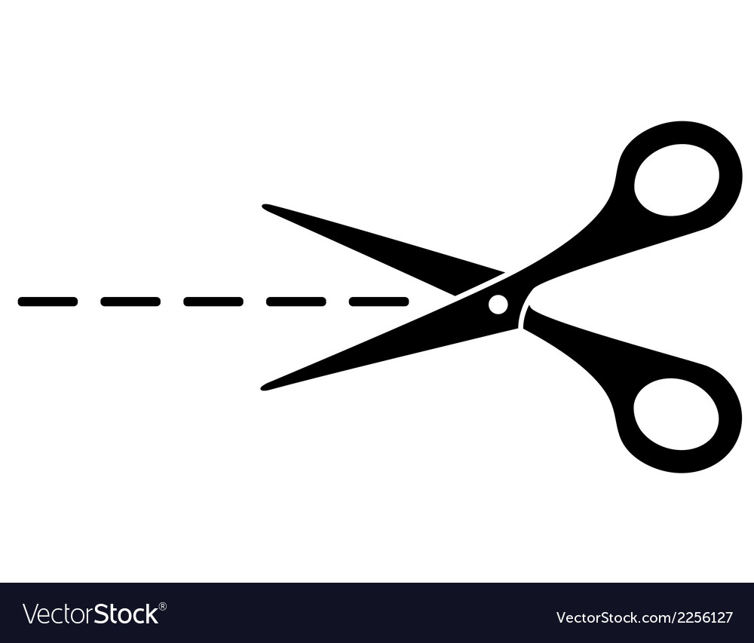
Volcanic Hazards
Hazard | Description | Picture
Volcanic bombs | Large pieces of rock and lava thrown out of a volcano at high speeds during an eruption.
Volcanic ash | Tiny pieces of rock and volcanic glass thrown into the air during an eruption. They can be inhaled and damage lungs, buildings and power lines.
Pyroclastic flow | A fast-moving, extremely hot cloud of gas, ash and volcanic material that can destroy everything in its path.
Lahar | A mix of water, mud, ash and rocks that rushes quickly down the side of a volcano or river valley.
Tsunami | Huge ocean waves caused by underwater volcanic eruptions that can travel across oceans and destroy coastal areas.
A
B
C
D
E
Activity 2: Fill in the blanks with the correct words below:
(social, economic, kill, bridges, environmental, buildings volcanic bombs, lahar, flood, pyroclastic flow, breathing, volcanic ash, tsunami, roads, habitats, homes)
A __________________ is a mixture of water, mud, ash and rocks that flows quickly down the side of a volcano. It can destroy _________ and __________. This is mainly an __________________ impact.
A __________________ is a huge ocean wave caused by an underwater volcanic eruption. It can _____coastal areas and destroy __________. This is an __________________ impact.
__________________ is made up of tiny pieces of rock and volcanic glass. It can be breathed in and cause __________ problems. This is a __________________ impact.
____________________ are large pieces of rock or lava thrown out of a volcano. They can damage _____________ and vehicles. This is mainly an __________________ impact.
A __________________ is a very hot, fast-moving mixture of gas, ash and volcanic material. It can _______ people and destroy ________. This is mainly a __________________ impact.
Volcanic hazards have a greater social/ economic/ environmental impact because
__________________________________________________________________________________________________________________________
The most dangerous volcanic hazard is __________________________________
This is because __________________________________________________
_____________________________________________________________

